Slide 1
OSM CAP Management System
HARISH NATARAJAN (S.E.I.T)
AKSHAR VASKAR (S.E.I.T)
DERECK CHAKOLA (S.E.I.T)

Slide 2
Existing system
After moderating exam paper the moderator have to manually enter the data in the excel.
The manually entering the data in excel sheet is time consuming and not secure.
The data entered in the excel is send to the higher authorities.
The excel system is not available to give update to higher authorities on an daily basis.

Slide 3
OSM CAP Management
To tackle the difficulties with the existing system we have made online system modelling for CAP.
With the OSM CAP MANAGEMENT system the moderator can update the data on the web-app which saves the data in the database.
The Django is used to create web-app because it is secure as compare to the php or other.
The admin or moderator can check the data of examined papers on the daily basis and it has login page for and authorized access.
the use of osm cap management system can help to track the data of examined papers with date and branch or even subject wise.

Slide 4
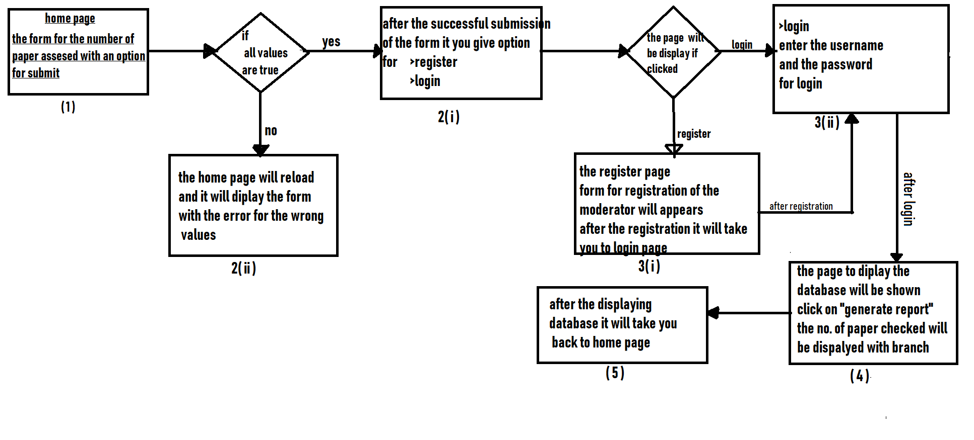
OSM CAP MANAGEMENT SYSTEM

Slide 5
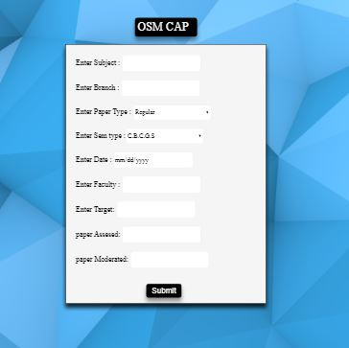
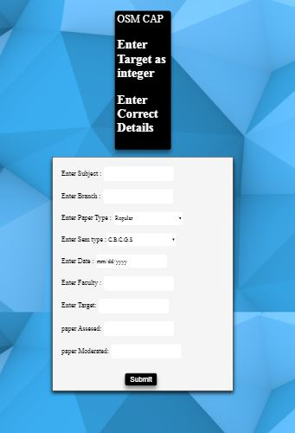
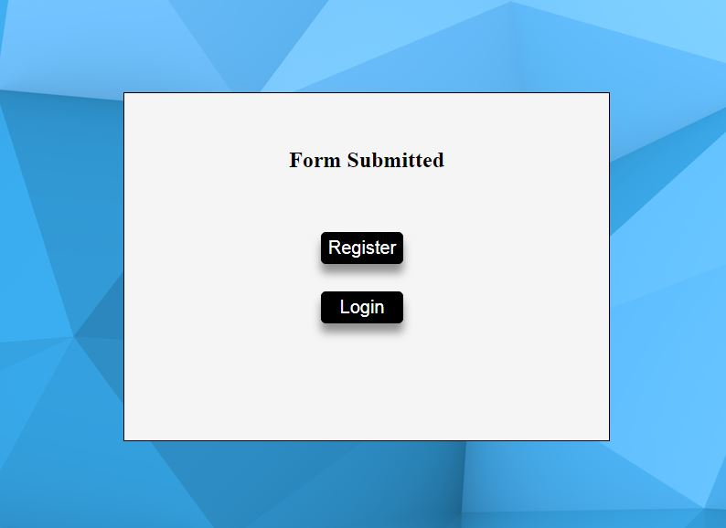
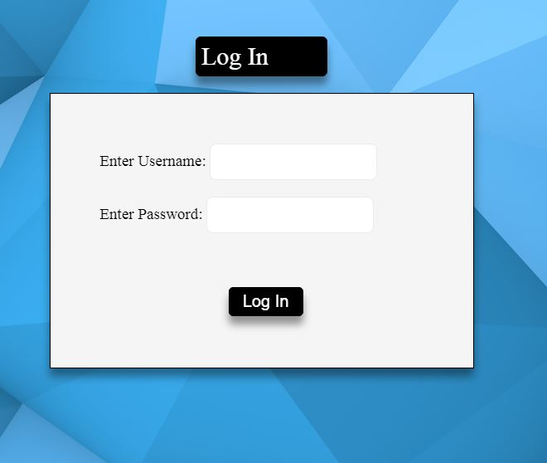
( Form with wrong values )
( Home page /
Form )
( Login page )
( Successful submission )

Slide 6
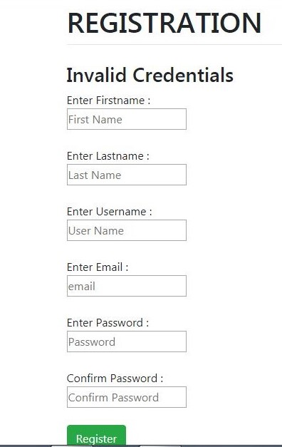
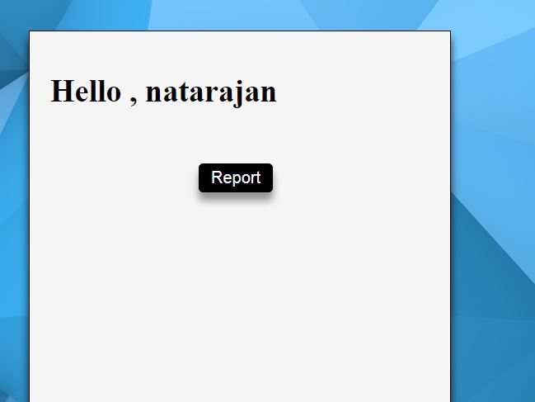
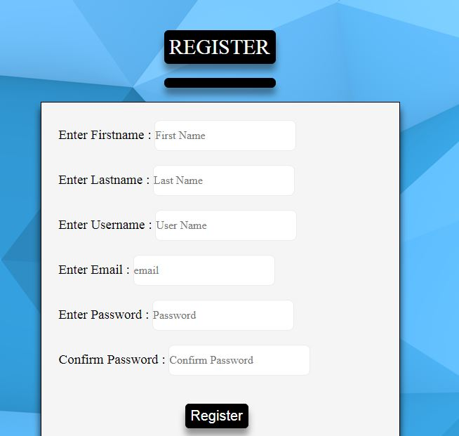
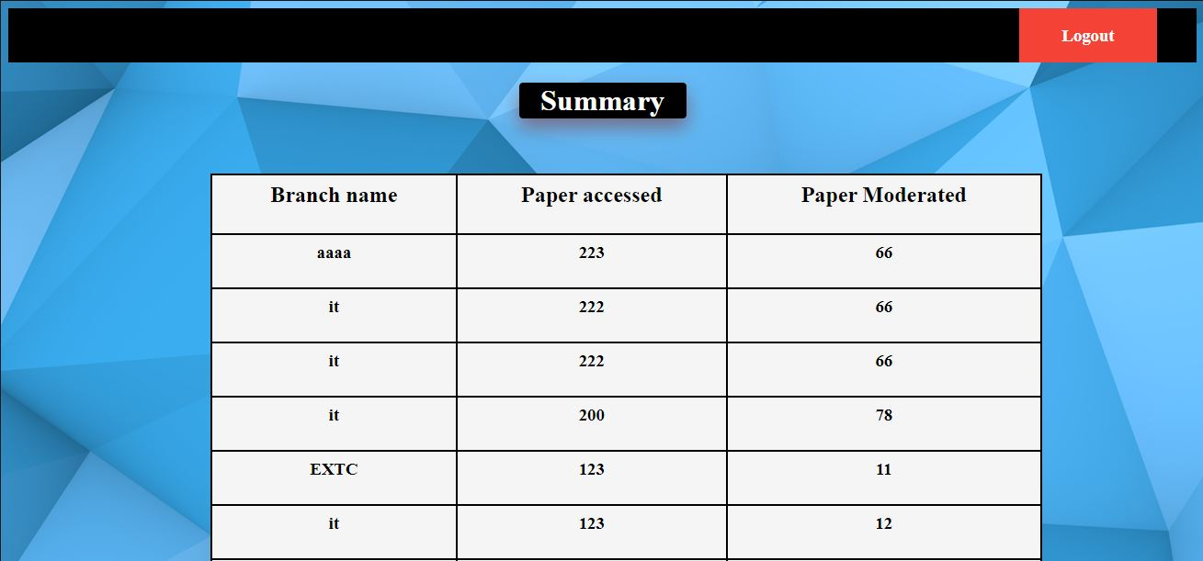
( Registration form )
( Generate report button )
( Database )

Slide 7
Technology used
Django
Python
HTML
CSS
Postgresql database

Slide 8
Django and Python
What is Django?
Django is an open-source framework for backend web applications based on Python — one of the top web development languages. Its main goals are simplicity, flexibility, reliability, and scalability.
The Django ORM
he ORM is an incredibly powerful database tool. It handles creation of your database, as well as insert, update, delete queries and some quite advanced querying It supports multiple databases - MySQL, PostgreSQL, Oracle & SQLite are all supported out-of-the-box assuming you have the relevant Python libraries installed.
Django is Python
Python is a favorite among many developers for its strong emphasis on readability and efficiency, especially when compared to other languages like Java, PHP.

Slide 9
HTML AND CSS
What is html
HTML (Hyper Text Markup Language) is the markup language which defines your page's layout.
What is css
CSS (Cascasding Style Sheets) is how your page is styled or the layout of the webpage.
Why to use html and css
Using HTML and CSS provides advantages to develop and deploy web content and web applications, to create refined and accurate web pages and web systems that operate across devices, operating systems and web browsers. Write once, run anywhere.

Slide 10
POSTGRESQL
What is postgresql
PostgreSQL supports advanced data types and advance performance optimization, features only available in the expensive commercial database, like Oracle and SQL Server.
Why to use postgresql
Compatible with various platforms using all major languages and middleware
PostgreSQL source code is freely available under an open source license. This allows you the freedom to use, modify, and implement it as per your business needs.
PostgreSQL is widely used in the Financial Industry, Government GIS data, Manufacturing, Web technology, and NoSQL and for Scientific Data collection works

Slide 11
THANK YOU

